Slide 1
Vector Semantics
Read Chapter 6 of
Speech and Language Processing (3rd ed draft)
Notes:
Comparing rows

Slide 2
Why vector models of meaning? Computing the similarity between words
“fast” is similar to “rapid”
“tall” is similar to “height”
Question answering:
Q: “How tall is Mt. Everest?” Candidate A: “The official height of Mount Everest is 29029 feet”

Slide 3
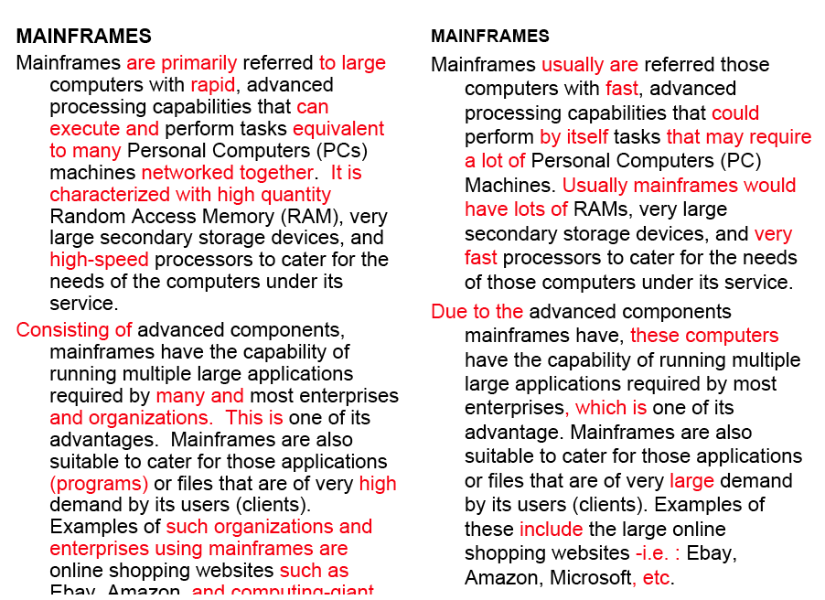
Word similarity for plagiarism detection

Slide 4
Distributional models of meaning = vector-space models of meaning = vector semantics
Intuitions: Zellig Harris (1954):
“oculist and eye-doctor … occur in almost the same environments”
“If A and B have almost identical environments we say that they are synonyms.”
Firth (1957):
“You shall know a word by the company it keeps!”

Slide 5
Intuition of distributional word similarity
Nida example:
A bottle of tesgüino is on the table
Everybody likes tesgüino
Tesgüino makes you drunk
We make tesgüino out of corn.
From context words humans can guess tesgüino means
an alcoholic beverage like beer
Intuition for algorithm:
Two words are similar if they have similar word contexts.

Slide 6
Intuition
Model the meaning of a word by “embedding” in a vector space.
The meaning of a word is a vector of numbers
Vector models are also called “embeddings”.
Contrast: word meaning is represented in many computational linguistic applications by a vocabulary index (“word number 545”)
Old philosophy joke:
Q: What’s the meaning of life?
A: LIFE’
Notes:
Vectors for representing words are generally called embeddings, because the word is embedded in a particular vector space.

Slide 7
Term-document matrix
Notes:
What is a document? Shakespeare’s plays, Wikipedia articles, IMDB movie reviews, speeches by politicians (SOTU addresses), real estate listings.
Rows: Abandon, Abdicate, Abhore, Academic … Zygodactyl, Zymergy

Slide 8
Term-document matrix
Each cell: count of term t in a document d: tf_{t,d}:
Each document is a count vector in ℕ^{v}: a column below
Notes:
ℕ^{v}: A vector of length V where the value of each of its element is a natural number.

Slide 9
Comparing the similarity of documents
Notes:
Ask – why compare the similarity of documents? / What tasks would document similarity help us solve.
Author attribution / plagiarism detection / document de-duplication
Clustering documents into categories
Recommendation systems

Slide 10
Comparing the similarity of documents
Author attribution / plagiarism detection / document de-duplication
Clustering documents into categories
Recommendation systems

Slide 11
Term-document matrix
Two documents are similar if their vectors are similar

Slide 12
The words in a term-document matrix
Each word is a count vector in ℕ^{D}: a row below

Slide 13
The words in a term-document matrix
Two words are similar if their vectors are similar

Slide 14
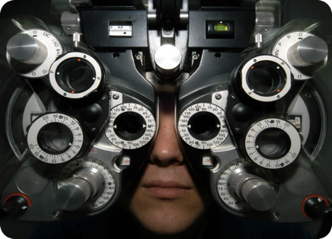
Distributional Hypothesis
If we consider optometrist and eye-doctor we find that, as our corpus of utterances grows, these two occur in almost the same environments. In contrast, there are many sentence environments in which optometrist occurs but lawyer does not...
It is a question of the relative frequency of such environments, and of what we will obtain if we ask an informant to substitute any word he wishes for optometrist (not asking what words have the same meaning).
These and similar tests all measure the probability of particular environments occurring with particular elements... If A and B have almost identical environments we say that they are synonyms.
–Zellig Harris (1954)
“You shall know a word by the company it keeps!”
–John Firth (1957)

Slide 15
Word-word matrix
Turney and Pantel (2010) From Frequency to Meaning: If units of text have similar vectors in a text-frequency matrix then they tend to have similar meanings.
Notes:
Rows: Abandon, Abdicate, Abhore, Academic … Zygodactyl, Zymergy
Columns: Abandon, Abdicate, Abhore, Academic … Zygodactyl, Zymergy

Slide 16
Defining a co-occurrence matrix
Notes:
Context window
Co-occur in the same document
Co-occur in the same sentence
Co-occur in the same window of words
More complex contexts like dependency patterns

Slide 17
DIRT
Lin and Panel (2001) operationalize the Distributional Hypothesis using dependency relationships to define similar environments.
Duty and responsibility share a similar set of dependency contexts in large volumes of text:
modified by adjectives | objects of verbs
additional, administrative, assigned, assumed, collective, congressional, constitutional ... | assert, assign, assume, attend to, avoid, become, breach ...

Slide 18
Define a co-occurrence matrix
…
…

Slide 19
Term-context matrix for word similarity
Two words are similar in meaning if their context vectors are similar

Slide 20
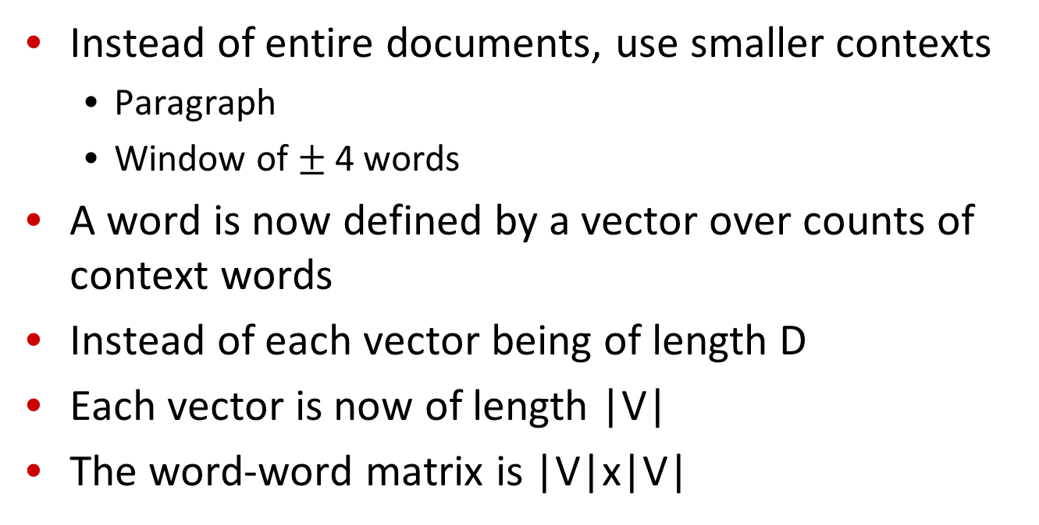
The word-word or word-context matrix
Instead of entire documents, use smaller contexts
Paragraph
Window of $±$ 4 words
A word is now defined by a vector over counts of context words
Instead of each vector being of length D
Each vector is now of length |V|
The word-word matrix is |V|x|V|

Slide 21
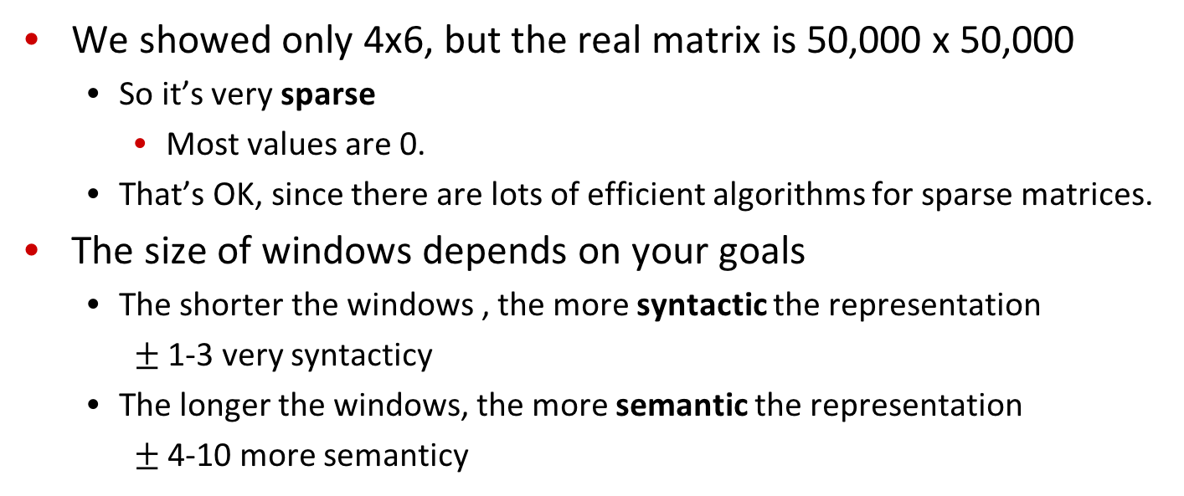
Word-word matrix
We showed only 4x6, but the real matrix is 50,000 x 50,000
So it’s very sparse
Most values are 0.
That’s OK, since there are lots of efficient algorithms for sparse matrices.
The size of windows depends on your goals
The shorter the windows , the more syntactic the representation
$±$ 1-3 very syntacticy
The longer the windows, the more semantic the representation
$±$ 4-10 more semanticy

Slide 22
Related versus similar
Related words
They are typically nearby each other.
wrote is related to words like book or poem.
Similar words
They have similar neighbors.
wrote is similar to words like said or remarked.

Slide 23
Vector Semantics
Measuring similarity: the cosine

Slide 24
Measuring similarity
Given 2 target words v and w
We’ll need a way to measure their similarity.
Most measure of vectors similarity are based on the:
Dot product or inner product from linear algebra
High when two vectors have large values in same dimensions.
Low (in fact 0) for orthogonal vectors with zeros in complementary distribution

Slide 25
Problem with dot product
Dot product is longer if the vector is longer. Vector length:
Vectors are longer if they have higher values in each dimension
That means more frequent words will have higher dot products
That’s bad: we don’t want a similarity metric to be sensitive to word frequency

Slide 26
Solution: cosine
Just divide the dot product by the length of the two vectors!
This turns out to be the cosine of the angle between them!

Slide 27
Cosine for computing similarity
Sec. 6.3
Dot product
Unit vectors
v_{i} is the PPMI value for word v in context i
w_{i} is the PPMI value for word w in context i.
Cos(v,w) is the cosine similarity of v and w

Slide 28
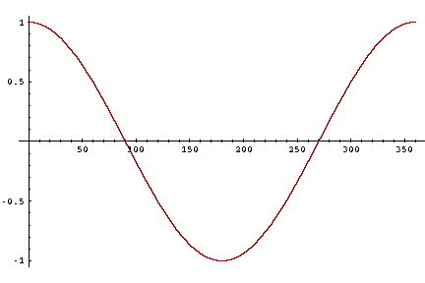
Cosine as a similarity metric
-1: vectors point in opposite directions
+1: vectors point in same directions
0: vectors are orthogonal
Raw frequency is non-negative, so cosine ranges between 0 and 1

Slide 29
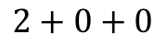
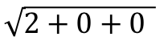
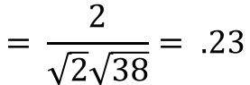
 | large | data | computer
apricot | 2 | 0 | 0
digital | 0 | 1 | 2
information | 1 | 6 | 1
Which pair of words is more similar?
cosine(apricot,information) =
cosine(digital,information) =
cosine(apricot,digital) =
$$2+0+0$$
$$= \frac{2}{\sqrt{2}\sqrt{38}}= .23$$
$$\sqrt{2+0+0 }$$

Slide 30
Visualizing vectors and angles
 | large | data
apricot | 2 | 0
digital | 0 | 1
information | 1 | 6

Slide 31
Clustering vectors to visualize similarity in co-occurrence matrices
Rohde et al. (2006)

Slide 32
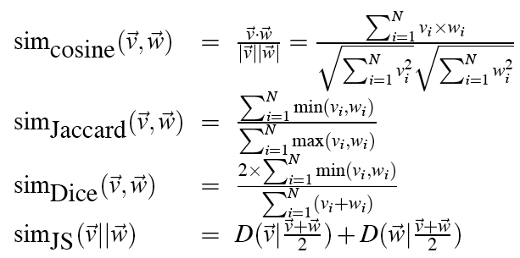
Other possible similarity measures

Slide 33
Vector Semantics
Measuring similarity: the cosine

Slide 34
Using syntax to define a word’s context
Zellig Harris (1968)
“The meaning of entities, and the meaning of grammatical relations among them, is related to the restriction of combinations of these entities relative to other entities”
Two words are similar if they have similar syntactic contexts
Duty and responsibility have similar syntactic distribution:
Modified by adjectives | additional, administrative, assumed, collective, congressional, constitutional …
Objects of verbs | assert, assign, assume, attend to, avoid, become, breach..

Slide 35
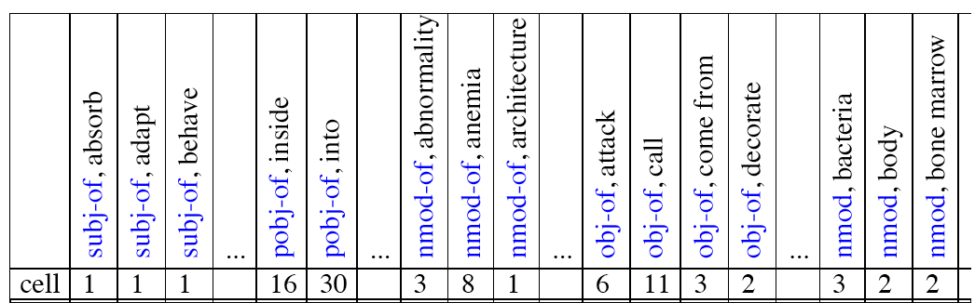
Co-occurrence vectors based on syntactic dependencies
Dekang Lin, 1998 “Automatic Retrieval and Clustering of Similar Words”
Each dimension: a context word in one of R grammatical relations
Subject-of- “absorb”
Instead of a vector of |V| features, a vector of R|V|
Example: counts for the word cell :

Slide 36
Syntactic dependencies for dimensions
Alternative (Padó and Lapata 2007):
Instead of having a |V| x R|V| matrix
Have a |V| x |V| matrix
But the co-occurrence counts aren’t just counts of words in a window
But counts of words that occur in one of R dependencies (subject, object, etc).
So M(“cell”,”absorb”) = count(subj(cell,absorb)) + count(obj(cell,absorb)) + count(pobj(cell,absorb)), etc.

Slide 37
TF-IDF
tf-idf (that’s a hyphen not a minus sign)
The combination of two factors
Term frequency (Luhn 1957): frequency of the word (can be logged)
Inverse document frequency (IDF) (Sparck Jones 1972)
N is the total number of documents
df_{i} = “document frequency of word i”
= # of documents with word I
w_{ij} = word i in document j
w_{ij}=tf_{ij} idf_{i}

Slide 38
TF-IDF
TF-IDF not generally used for word-word similarity
But is by far the most common weighting when we are considering the relationship of words to documents

Slide 39
Vector Semantics
Positive Pointwise Mutual Information (PPMI)

Slide 40
Problem with raw counts
Raw word frequency is not a great measure of association between words
It’s very skewed
“the” and “of” are very frequent, but maybe not the most discriminative
We’d rather have a measure that asks whether a context word is particularly informative about the target word.
Positive Pointwise Mutual Information (PPMI)

Slide 41
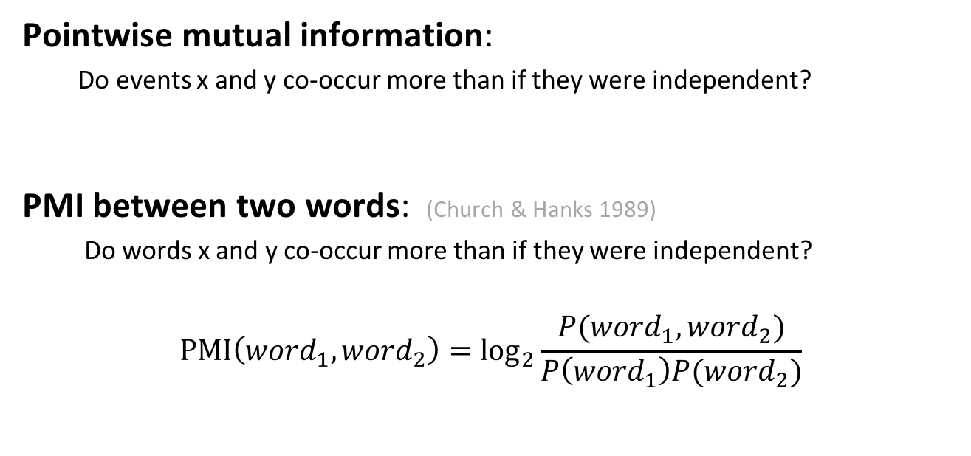
Pointwise Mutual Information
Pointwise mutual information:
Do events x and y co-occur more than if they were independent?
PMI between two words: (Church & Hanks 1989)
Do words x and y co-occur more than if they were independent?
$$\text{PMI}\left({word}_{1}, {word}_{2}\right)={\text{log}}_{2}\frac{P({word}_{1}, {word}_{2})}{P\left({word}_{1}\right)P({word}_{2})}$$

Slide 42
PMI applied to dependency relations
Hindle, Don. 1990. Noun Classification from Predicate-Argument Structure. ACL
Object of “drink” | Count | PMI
it | 3 | 1.3
anything | 3 | 5.2
wine | 2 | 9.3
tea | 2 | 11.8
liquid | 2 | 10.5
Object of “drink” | Count | PMI
tea | 2 | 11.8
liquid | 2 | 10.5
wine | 2 | 9.3
anything | 3 | 5.2
it | 3 | 1.3
“Drink it” more common than “drink wine”
But “wine” is a better “drinkable” thing than “it”

Slide 43
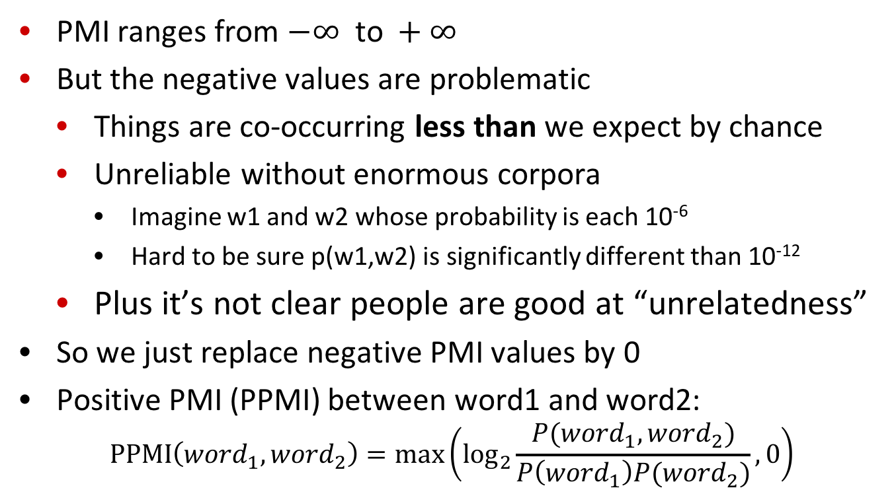
Positive Pointwise Mutual Information
PMI ranges from $−∞ \text{to} +∞$
But the negative values are problematic
Things are co-occurring less than we expect by chance
Unreliable without enormous corpora
Imagine w1 and w2 whose probability is each 10⁻⁶
Hard to be sure p(w1,w2) is significantly different than 10⁻¹²
Plus it’s not clear people are good at “unrelatedness”
So we just replace negative PMI values by 0
Positive PMI (PPMI) between word1 and word2:
$$\text{P}\text{P}\text{MI}\left({word}_{1}, {word}_{2}\right)=\max\left({\text{log}}_{2}\frac{P({word}_{1}, {word}_{2})}{P\left({word}_{1}\right)P({word}_{2})},0\right)$$

Slide 44
Computing PPMI on a term-context matrix
Matrix F with W rows (words) and C columns (contexts)
f_{ij} is # of times w_{i} occurs in context c_{j}

Slide 45
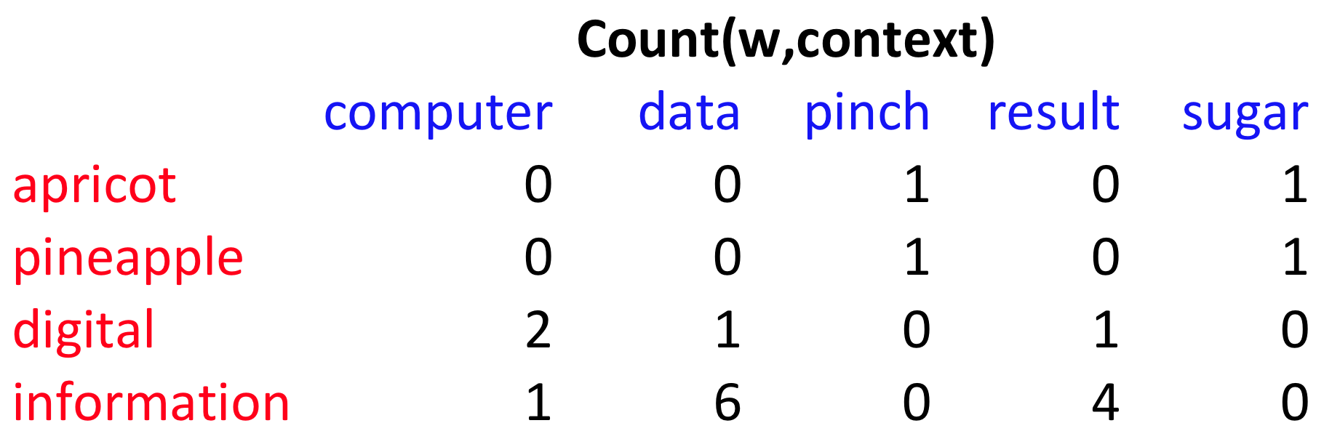
p(w=information,c=data) =
p(w=information) =
p(c=data) =
6/19
= .32
11/19
= .58
7/19
= .37

Slide 46
pmi(information,data) = log₂ (
.32 /
(.37*.58) )
= .58
(.57 using full precision)

Slide 47
Weighting PMI
PMI is biased toward infrequent events
Very rare words have very high PMI values
Two solutions:
Give rare words slightly higher probabilities
Use add-one smoothing (which has a similar effect)

Slide 48
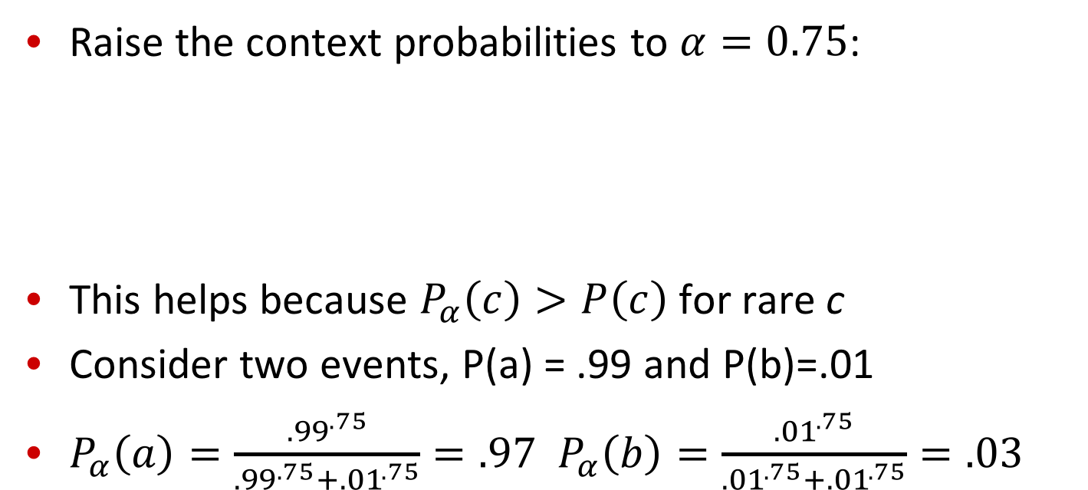
Weighting PMI: Giving rare context words slightly higher probability
Raise the context probabilities to $α=0.75$:
This helps because $P_{α}\left(c\right)>P\left(c\right)$ for rare c
Consider two events, P(a) = .99 and P(b)=.01
$P_{α}\left(a\right)=\frac{{.99}^{.75}}{{.99}^{.75}+{.01}^{.75}}=.97$ $P_{α}\left(b\right)=\frac{{.01}^{.75}}{{.01}^{.75}+{.01}^{.75}}=.03$

Slide 49
Use Laplace (add-1) smoothing

Slide 51
PPMI versus add-2 smoothed PPMI

Slide 52
Vector Semantics
Evaluating similarity

Slide 53
Evaluating similarity
Extrinsic (task-based, end-to-end) Evaluation:
Question Answering
Spell Checking
Essay grading
Intrinsic Evaluation:
Correlation between algorithm and human word similarity ratings
Wordsim353: 353 noun pairs rated 0-10. sim(plane,car)=5.77
Taking TOEFL multiple-choice vocabulary tests
Levied is closest in meaning to:
imposed, believed, requested, correlated

Slide 54
Summary
Distributional (vector) models of meaning
Sparse (PPMI-weighted word-word co-occurrence matrices)
Dense: Next lecture!

